Slide 1

Google Forms Test Lock Bypass: Ranked Methods
By: Dennis Freyman

Slide 2

Introduction to Google Forms Security
2.5B
92%
Forms Created
Organization Use
Google Forms created annually worldwide
Of businesses utilize Google Forms regularly
A Lot
Mira Costa Movement
Many classes moving to google form test taking including APs.

Slide 3
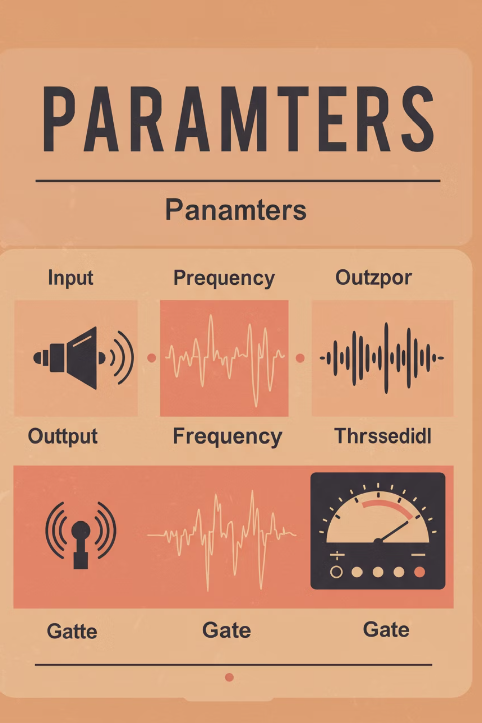



Considered Parameters
Google form locks check for Chrome OS
This means no home devices
Device is managed by the school
No extensions, crosh, many websites and domains blocked
Assuming regular testing conditions
some kind of proctoring, other students watching you etc.

Slide 4

Method 1 - Two Person Fake AP HTML Extraction
Execution Steps: (requires a second person)
Set up a Raspberry Pi or Kali laptop with a wireless card that supports monitor mode.
Use hostapd to create a fake Wi-Fi AP with the same SSID as the school network.
Automatically Intercept and Serve the Real Form
can be done with a very lightweight flask server
The person on the server can now locally open the html on their computer, read the questions, and get an unfair advantage

Slide 5
How Google Forms Test Lock Works
ChromeOS Verification: Test locks verify device is running authentic ChromeOS before allowing access to secured forms
Repetitive Admin Console management verification checks
Runs as a seperate window (almost like a seperate application)
In theory, allows for background execution with the right setup

Slide 6








Method 2 - Rubber Ducky Input Injection
Chrome Tab Spawn Crash
Injects a javascript: URL into the browser (hundreds of tabs)
Eventually freezes Chrome OS's UI
Force-closes the test environment, often crashes UI. Upon relogin, chrome will cache the form, but no longer locked.
Option 2 (Similar)
Hidden Crosh Shell Entry
Use overwhelming amount of tabs to launch crosh shell, work from there
will let you ssh out, and from that point its easy

Slide 7

Method 3: Wi-Fi Evil Twin + Captive Portal Crash Injection
Start with the access point like before
2. Use aireplay-ng or mdk4 to kick the device off the other network, connecting to the fake one.
3. Automated captive portal JS script that runs upon connection, crashing test env.
4. Login in and search answers.

Slide 8




Method 4: HDMI/USB-C Live Screen Capture
Note: the type of port will depend on chromebook model
Capture + Receiving
Remote Dongle
Plug In During the Test
Newer dongles have capability to broadcast to a stream close by remotely via wifi/bluetooth
A capture device (Cam Link, ClonerAlliance, etc.)
Have outside person with a different device
A receiving device (like a laptop, Raspberry Pi)
write down the questions, log the answers, etc.
($50)

Slide 9
Feasibility Checkpoint

Slide 10
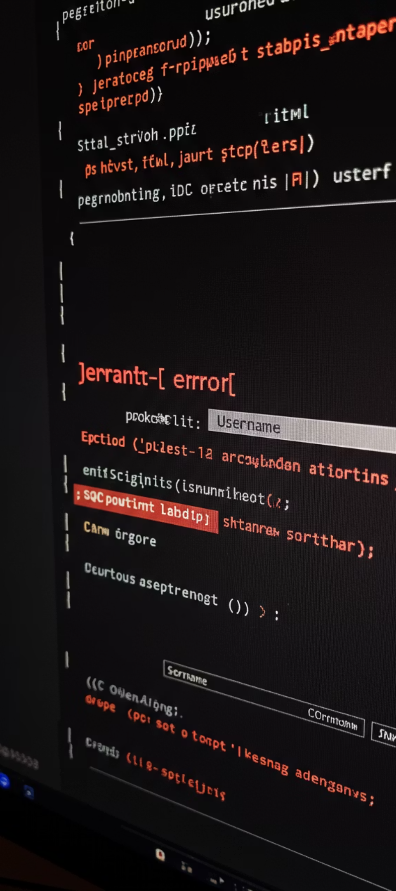
Method 5: Cold Boot RAM Dump
1. Access
2. USB
Gain access to the chromebook shortly after it is powered off.
Insert a USB with a live linux distro. Can be loaded off a chromebook via ESC + Refresh + Power, then booting from USB.
remove the write-protect screw
3. Dump the RAM
Assuming the device was powered off very recently, data on RAM lingers on chromebooks. Therefore once linux boots:
run a memdump and save it
use a tool like LIME to scan memory
Analyze the Dump and IF YOU ARE LUCKY & FAST, you might find entire HTML form structures, cached Google Form text, answers, etc.

Slide 11






Methodology 6: Powerline Signal Injection & Remote Trigger Hijack
Researched and proven theoretically possible by research done at Cornell University and University of British Columbia
2. Raspberry Pi
un a script on the Pi that sends a special pattern of electricity into the outlet
1. Teacher's Computer
Plugging in a USB stick that runs a silent script, or something else.
3. The Teacher’s Computer Reacts
It opens the test page
Emails them to a secret inbox
Sends them to a shared drive or local Wi-Fi storage

Slide 12
Methodology 7: Firmware Flash + Coreboot Takeover
Note: You need like 3 hours with the Chromebook
Open the chromebook, and inside of it locate the write-protect screw or pad. Unscrew it or place electrical tape over it
Flash Custom Firmware: MrChromebox firmware tool
Flash Full ROM
Boot Into Your Own OS
Do whatever you wanna do now (any of the previous methods, ssh, terminal access, preset commands/crashes etc)

Slide 13

Legal and Ethical Considerations
Action
Legal Status
Ethical Status
Testing own forms
Legal
Ethical
Testing with permission
Legal
Ethical
Unauthorized access
Illegal
Unethical
Data exfiltration
Illegal
Unethical
Cheating on tests
Academically Dishonest
Unethical

Slide 14

Thank You!

